Slide 1
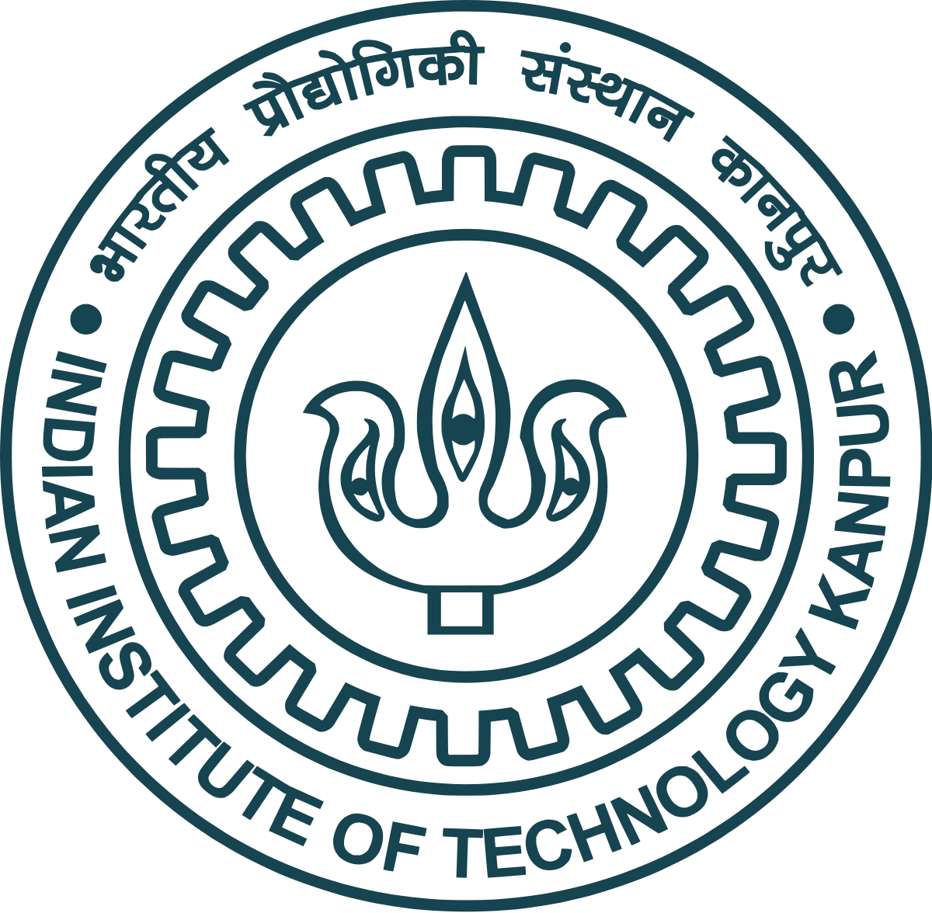
Lecture 19
Fundamentals and Applications (CSO201A)
Dr. Srinivas Dharavath
Assistant Professor
Department of Chemistry
Indian Institute of Technology, Kanpur
Kanpur- 208016
E-mail: srinivasd@iitk.ac.in

Slide 2


Coupling Reaction
A coupling reaction in organic chemistry is a general term for a variety of reactions where two fragments are joined together with the aid of a metal catalyst. In one important reaction type, a main group organometallic compound of the type R-M (R = organic fragment, M = main group center) reacts with an organic halide of the type R'-X with formation of a new carbon-carbon bond in the product R-R'. The most common type of coupling reaction is the cross coupling reaction
Homo-coupling types
Cross-coupling types
Homo-coupling types: A) Wurtz reaction. B) Pinacol coupling reaction. C) Glaser coupling. D) Ullmann reaction
Cross-coupling types: A) Grignard reaction. B) Negishi coupling. C) Stille cross coupling. D) Suzuki reaction. E) Buchwald-Hartwig reaction. F) Sonogashira coupling. G) Heck reaction. H) Kumada coupling.

Slide 3
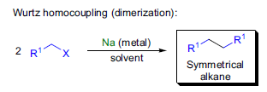
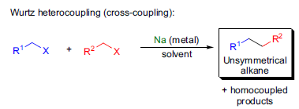
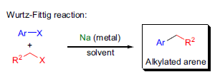
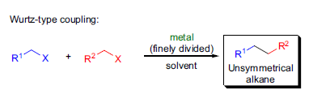

1. Homo-coupling types
A) Wurtz Reaction
The coupling of two sp³-carbon centers by the treatment of alkyl or benzyl halides with sodium metal is known as the Wurtz coupling. When metals other than sodium are used, this transformation is referred to as a Wurtz type coupling. The coupling of an alkyl and an aryl halide in the presence of sodium metal to get the corresponding alkylated aromatic compound is called the Wurtz-Fittig reaction.

Slide 4
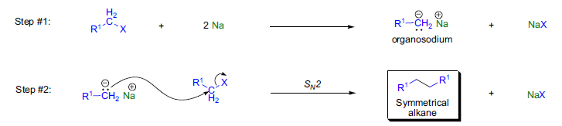
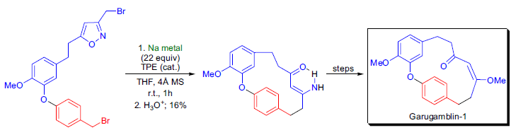

The mechanism of the Wurtz coupling is not well understood, and the currently accepted mechanism involves two steps: 1) formation of a carbanionic organosodium compound via metal-halogen exchange; and 2) the displacement of the halide ion by the organosodium species in an SN2 reaction. Alternatively, a radical process can also be envisioned, although to date there has been no experimental evidence to support this assumption.

Slide 5
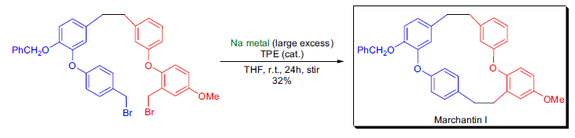
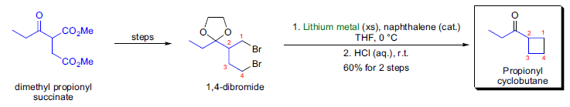


Slide 6
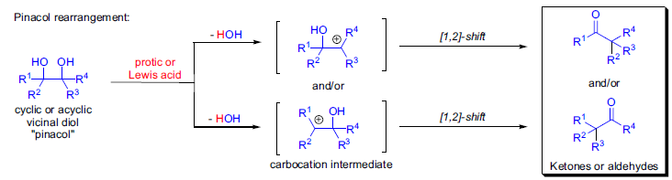
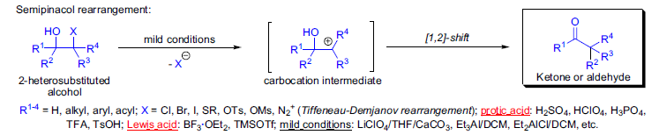
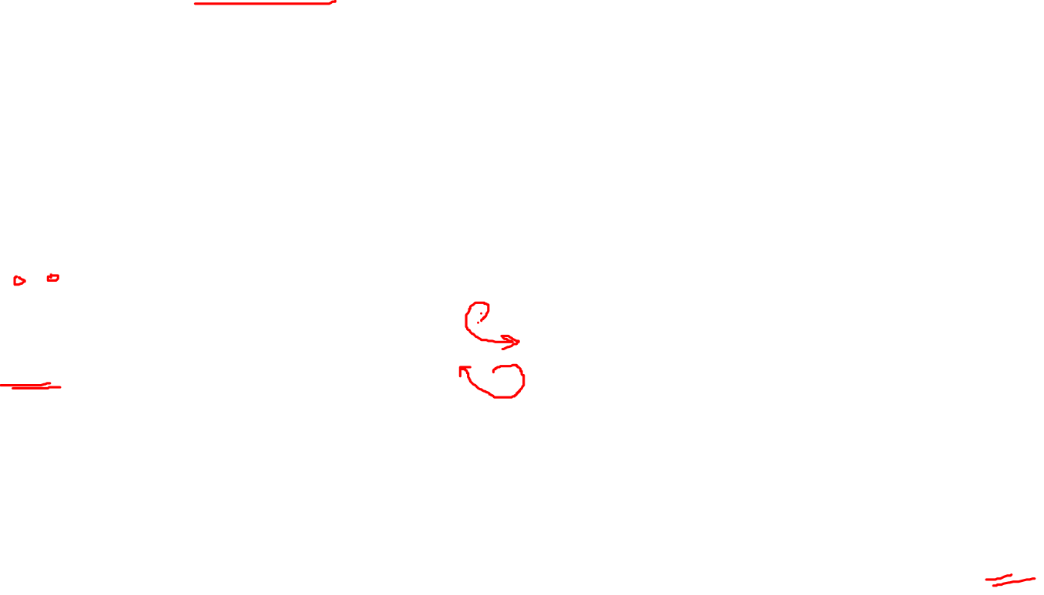
B) Pinacol Rearrangement
This acid-catalyzed transformation of vicinal diols is known as the pinacol rearrangement. The general features of the reaction are: 1) virtually any cyclic or acyclic vicinal glycol can undergo the rearrangement, and, depending on the substitution pattern, aldehydes and/or ketones are formed; 2) when all four substituents are identical, the rearrangement yields a single product; 3) when the four substituents are not identical, product mixtures are formed; 4) the product is usually formed via the most stable
carbocation intermediate when the glycol substrate is unsymmetrical.

Slide 7
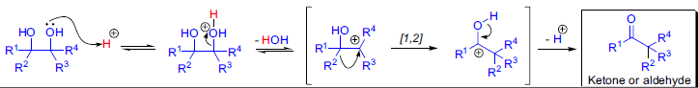
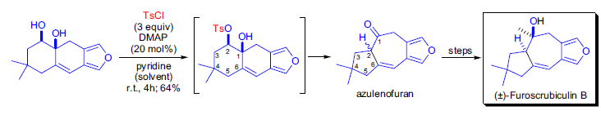
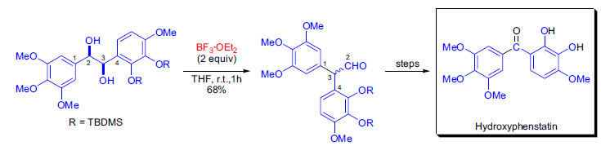

The first step of the process is the protonation of one of the hydroxyl groups, which results in the loss of a water molecule to give a carbocation intermediate. This intermediate undergoes a [1,2]-shift to give a more stable carbocation that upon the loss of proton gives the product. The pinacol rearrangement was shown to be exclusively intramolecular, and both inversion and retention were observed at the migrating center.

Slide 8
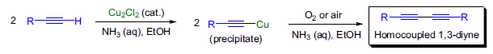
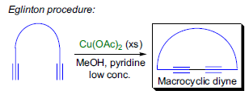
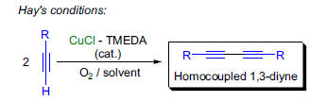

C) Glaser Coupling
The preparation of symmetrical conjugated diynes and polyynes (linear or cyclic) by the oxidative homocoupling of terminal alkynes in the presence of copper salts is known as the Glaser coupling. There are numerous versions of the original procedure developed by Glaser, and these differ mainly in the type and amount of oxidants used: 1) besides oxygen and air, CuCl2 and K3Fe(CN)6 are used most often as oxidizing agents; 2) Glaser’s procedure was heterogeneous and slow, but G. Eglinton and A.R. Galbraith showed that using Cu(OAc)2 in methanolic pyridine made the process homogeneous and faster (Eglinton procedure). This method was successfully applied to the synthesis of macrocyclic diynes and 3) A.S. Hay used tertiary amines such as pyridine or the bidentate ligand TMEDA as complexing agents to solubilize the Cu(I)-salt. Next, oxygen gas was passed through this solution to give the homocoupled product in a few minutes at room temperature in almost quantitative
yield (Hay coupling conditions)

Slide 9
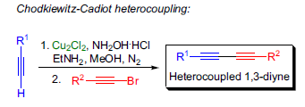
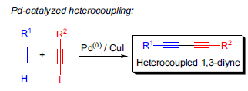
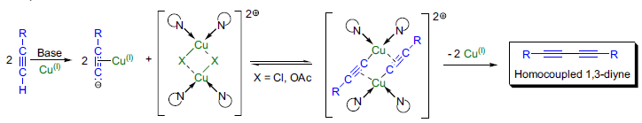

The mechanism of the Glaser coupling and related methods is very complex and is not fully understood. Studies revealed that the mechanism is highly dependent on the experimental conditions. The early proposal involving a radical mechanism has been rejected. The currently accepted mechanism involves dimeric copper(II)acetylide complexes.

Slide 10
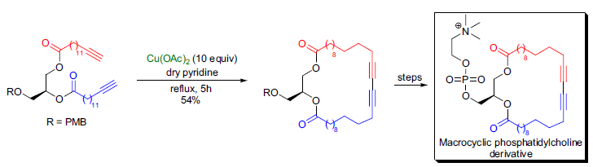
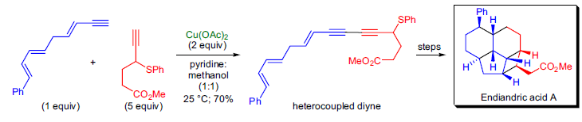


Slide 11
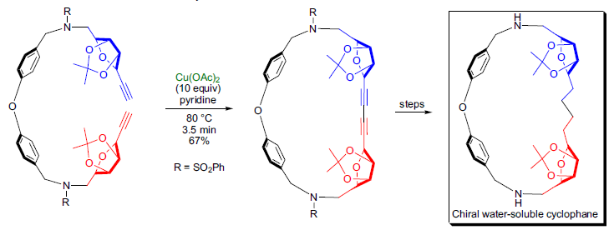
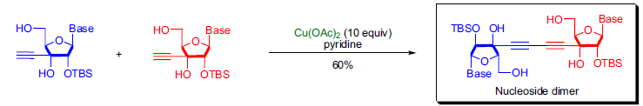
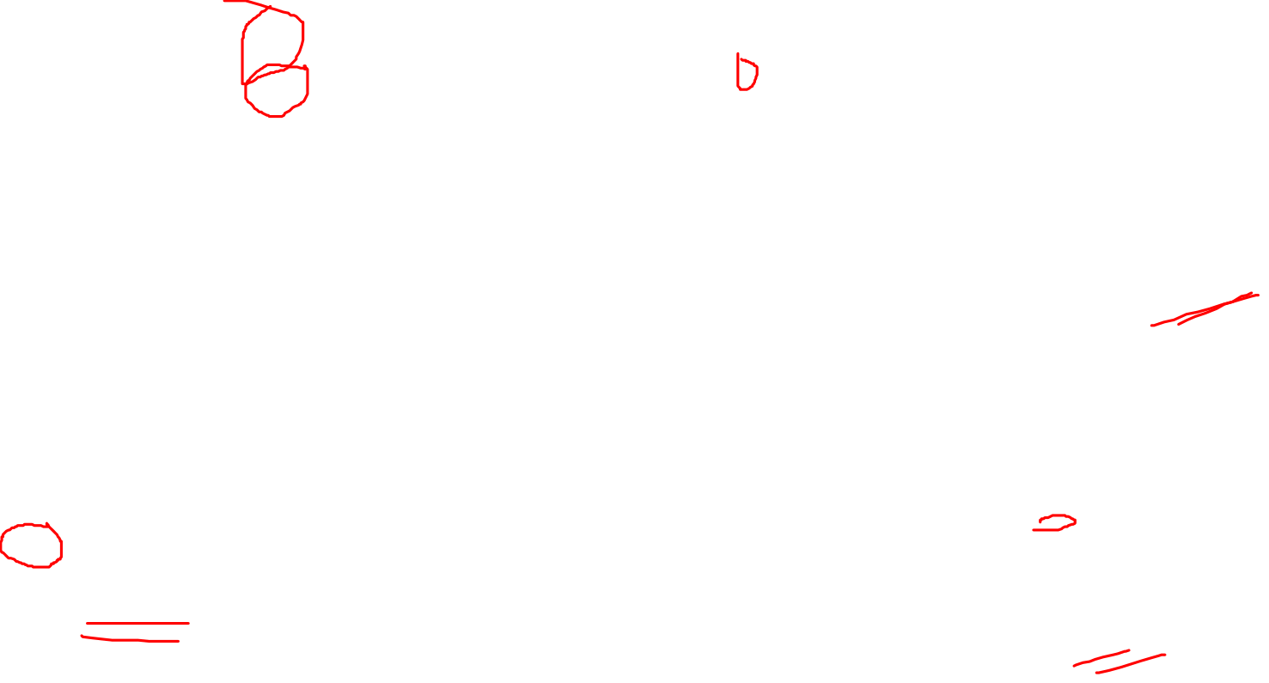

Slide 12
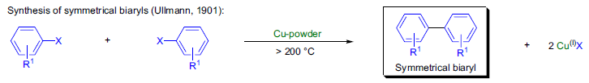
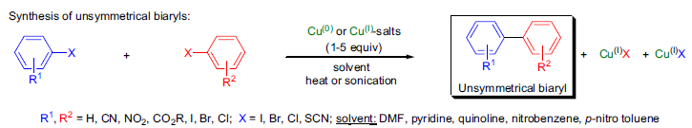

D) Ullmann Reaction/Coupling /
Biaryl Synthesis
This condensation of two aryl halides in the presence of copper to give symmetrical or unsymmetrical biaryls is now referred to as the Ullmann reaction (Ullmann biaryl synthesis or Ullmann coupling).

Slide 13
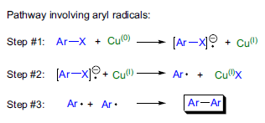
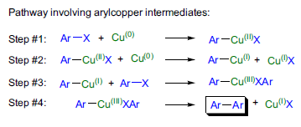
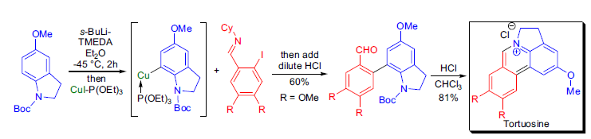

The exact mechanistic pathway of the Ullmann coupling is not known. There are two main pathways possible: 1) formation of aryl radicals or 2) the formation of aryl copper [ArCu(I), ArCu(II) and ArCu(III)] intermediates. Currently the most widely accepted mechanism assumes the formation of aryl copper intermediates, since many of these species can be isolated and they can react with aryl halides to give biaryls.

Slide 14
